Slide 1

Skyline hotel website
Teacher: Le Van Minh
Student members :
Tran Quoc Tinh – 19IT5
Tran Nhat Tan – 19IT5
Nguyen Dang Quy – 19IT4
Notes:
Hello everyone
My name is Tran Quoc Tinh, I’m from class 19IT5
welcome to our presentation
I want to make you a short presentation about project “..”
In this presentation, I have four main points
Firstly The reason for choosing the topic,
secondly Object of the system
,
thirdly Steps to be performed,
and finfally How to make money
so, first I will present about The reason for choosing the topic.....
I’d now like to move on to Object of the system
Includes 4 Actors
About admin has features such as
....
About Users has features such as
....
About Cashier management
has features such as
....
About Manage reservations
has features such as
...
Cashier

Slide 2


Skyline hotel website
1
The reason for choosing the topic
2
Object of the system
3
Steps to be performed
4
How to make money?

Slide 3
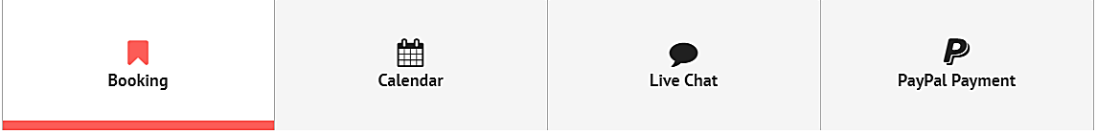
1. The reason for choosing the topic
The application in activities of "Hotel booking website" has brought many meanings such as:
Help consumers get accurate hotel prices and images.
Helps managers more easily manage products. Managers can quickly figured the number of customers to help their hotel business become better.

Slide 4
2. Object of the system
Admin
Users
Admin Dashboard
Profile & Change Password
Payment & Paypal Settings
Services Management
Users Management
Bookings Management
User Dashboard
Profile & Change Password
Live Chat
Booking/Reservation Calendar
Bookings List/History
Export Bookings
Transactions List/History
Export Transactions
PayPal Payment

Slide 5
2. Object of the system
Cashier management
Manager reservations
Profile & Change Password
Live Chat & Notifications
Export Bookings
Transactions Management
Enquiries Management
Profile & Change Password
Live Chat & Notifications
Bookings Management
Enquiries Management

Slide 6
3. Steps to be performed
Step 1: Research overview of the topic, discuss together, outline the project
Step 2: Outline preliminary website layout, prepare and master the knowledge to build a website.

Slide 7


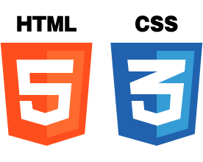


3. Steps to be performed
Step 3: Programming website (code web). Using programming languages and framework

Slide 8

3. Steps to be performed
Create database about customer accounts and information of hotel by:

Slide 9
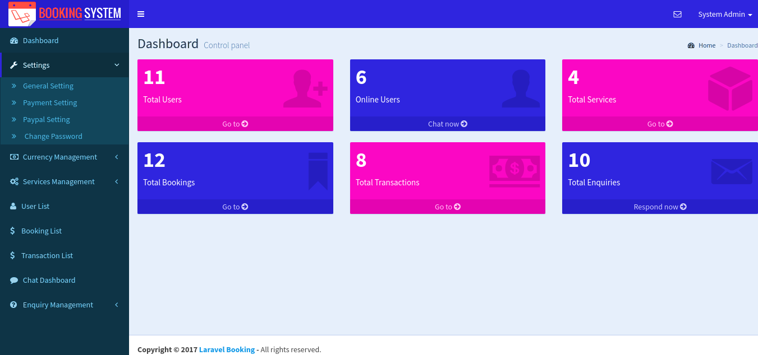
3. Steps to be performed
Step 4: Build website administration page

Slide 10
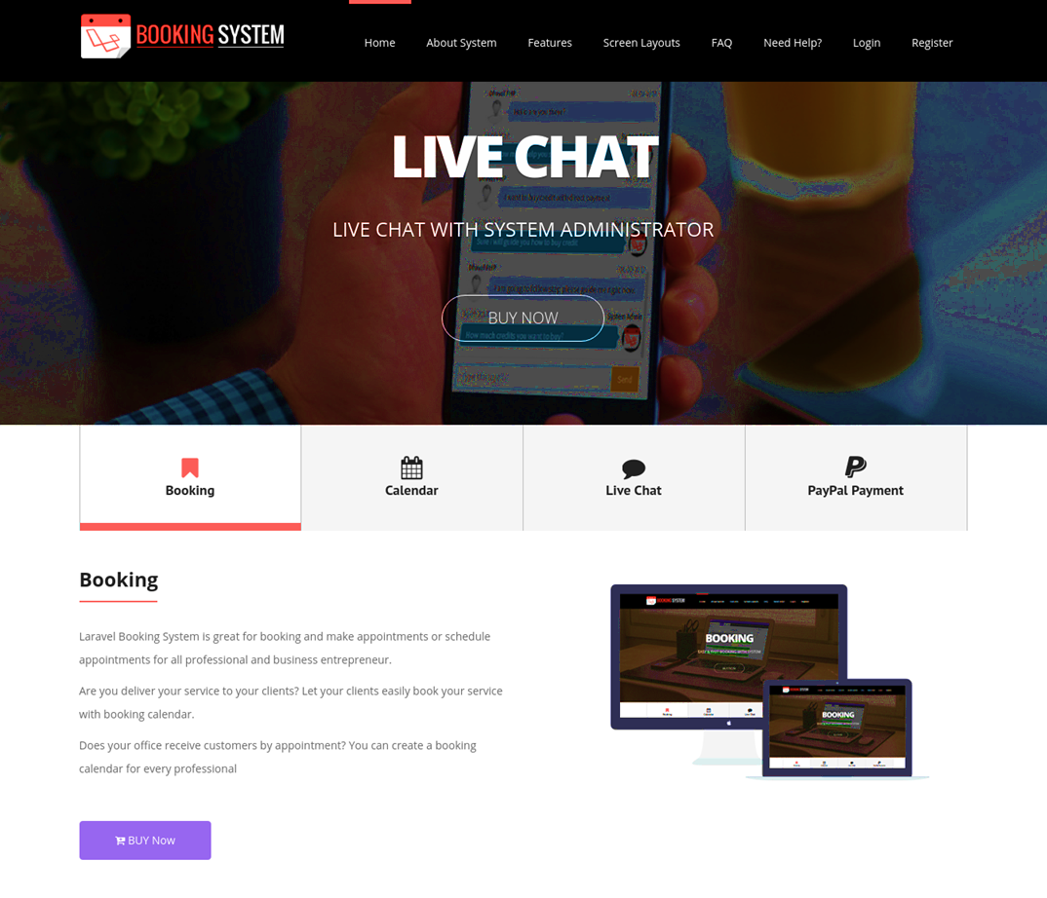
3. Steps to be performed
Step 5: Build user home pages and slides

Slide 11


3. Steps to be performed
Step 6: Rent a domain name and hosting

Slide 12

3. Steps to be performed
Step 7: Review and refine website.

Slide 13

3. How to make money?
Notes:
Selling website system for businesses in need

Slide 14



3. How to make money?
ADS
Notes:
Selling advertising space on the website

Slide 15



3. How to make money?
Notes:
Collect money through the user premium package

Slide 16




3. How to make money?
Notes:
Setting up a donation button on the website allows customers to make a direct donation, if the customer is satisfied with the service quality at the hotel. Link them to payment tools like PayPal, Stripe, Fundly.

Slide 17
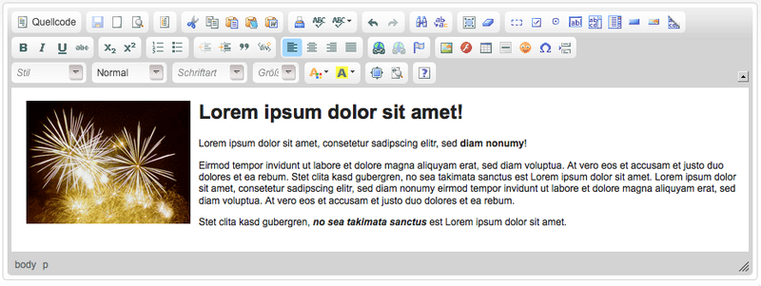
3. How to make money?
Notes:
Create sponsored content with collaborative brands, businesses pay to create content for them and publish it on their website

Slide 18

3. How to make money?
Selling website system for businesses in need
Selling advertising space on the website
Collect money through the user premium package
Setting up a donation button on the website allows customers to make a direct donation. Link them to payment tools like PayPal, Stripe, Fundly.
Create sponsored content with collaborative brands, businesses pay to create content for them and publish it on their website
Notes:
Chefs, Dentists, Doctors, Hairdresser
Đầu bếp, nha sĩ, bác sĩ, thợ làm tóc
Bán website cho các doanh nghiệp có nhu cầu
Bán không gian quảng cáo trên trang web
Thu tiền thông qua gói cao cấp của người dùng
Việc thiết lập nút quyên góp trên website cho phép khách hàng quyên góp trực tiếp, nếu khách hàng hài lòng với chất lượng dịch vụ tại khách sạn. Liên kết chúng với các công cụ thanh toán như PayPal, Stripe, Fundly.
Tạo nội dung được tài trợ với các thương hiệu hợp tác, doanh nghiệp trả tiền để tạo nội dung cho họ và xuất bản nó trên trang web của họ

Slide 19

Notes:
Today I am here to present to you about project "Skyline hotel website".
My presentation is divided into 4 parts
Firstly The reason for choosing the topic,
secondly Object of the system
,
thirdly Steps to be performed,
and finfally How to make money
so, first I will present about The reason for choosing the topic.....
I’d now like to move on to Object of the system
About admin has features such as
....
About Users has features such as
....
About Cashier management
has features such as
....
About Manage reservations
has features such as
...
Cashier

